Slide 1
Bird Strikes Data Visualization

Slide 2
Objective:
Visualizing the Bird Strikes in US between 2000 - 2011. The Data Visualization will help to understand the effects of birds strikes in US.
Benefits:
Detection of upcoming strikes effects.
Gives better insight of strikes effects.
Helps in easy flow for managing resources.
Reducing the impacts in future.

Slide 3
Data Sharing Agreement :
Sample file name (ex Bird Strikes_Final.csv)
Size of file : 21.7 MB
Number of Columns 26
Column data type Integers, strings, and Date time

Slide 4
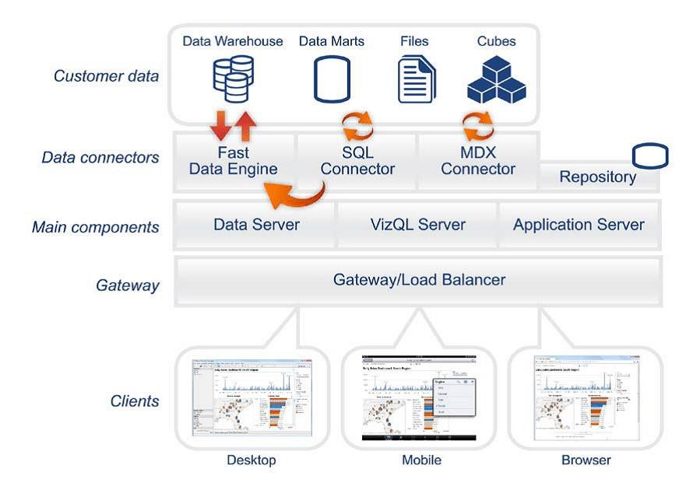
Architecture

Slide 5
Data Validation and Data Transformation :
Name Validation - Validation of files name as per the DSA. We have created a regex pattern for validation. After it checks for date format and time format if these requirements are satisfied, we move such files to "Good_Data_Folder" else "Bad_Data_Folder.“
Number of Columns – Validation of number of columns present in the files, and if it doesn't match then the file is moved to "Bad_Data_Folder.“
Name of Columns - The name of the columns is validated and should be the same as given in the schema file. If not, then the file is moved to "Bad_Data_Folder".
Data type of columns - The data type of columns is given in the schema file. It is validated when we insert the files into Database. If the datatype is wrong, then the file is moved to "Bad_Data_Folder".
Null values in columns - If any of the columns in a file have all the values as NULL or missing, we discard such a file and move it to "Bad_Data_Folder".

Slide 6
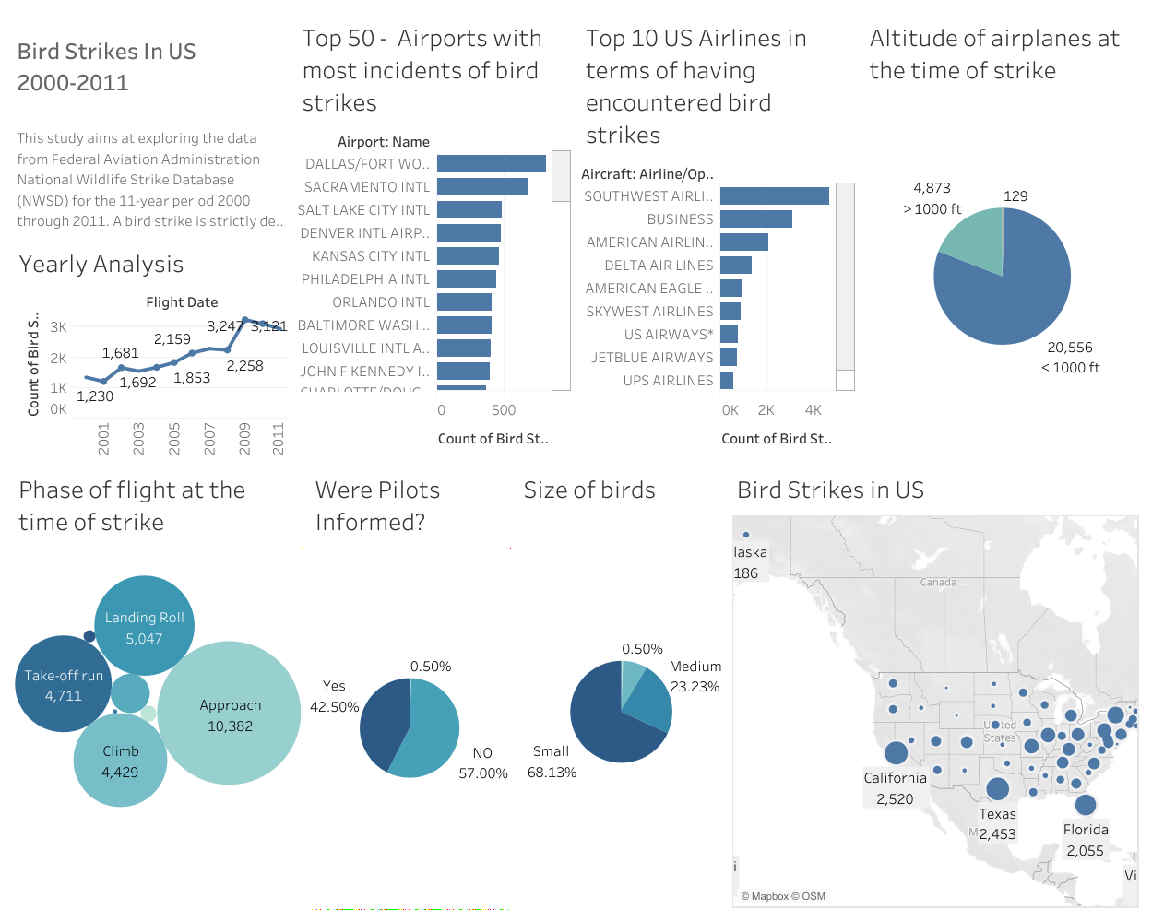
Dashboard 1

Slide 7
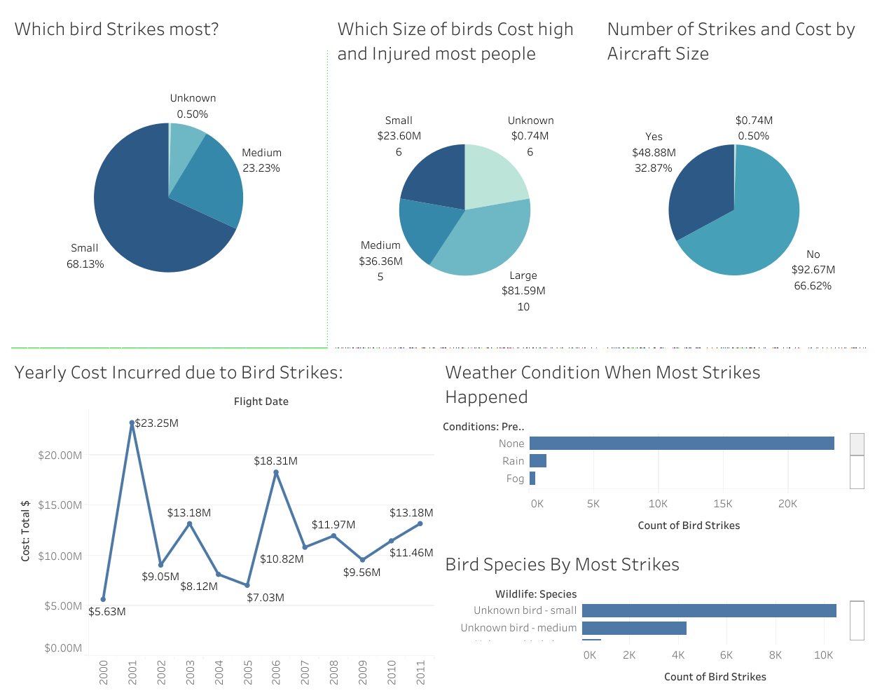
Dashboard 2

Slide 8
Q & A:
Q1) What’s the source of data?
The data for Visualizing is provided by the client.
Q 2) What was the type of data?
The data was the combination of Integer, string, and date time.
Q 3) After the File validation what you do with incompatible file or files which didn’t pass the validation?
Files like these are moved to the Achieve Folder and a list of these files has been
shared with the client and we removed the bad data folder.

Slide 9
Q 6) What techniques were you using for data pre-processing?
Removing Duplicates
Visualizing relationship of different variables
Cleaning data and imputing if null values are present.
Converting categorical data into numeric values.
Q7) In which month of year most bird strikes occurs?
August, September, and July has the highest number of bird strikes in order.
Q8) What are effects of prior warnings of bird strikes?
Most of the time pilots were uninformed hence the damaged cost increased.

